Slide 1
Machine Learning DSECL ZG565
Support Vector Machines
Dr. Monali Mavani
These slides are prepared by the instructor, with grateful acknowledgement of Tom Mitchell, Andrew Ng< Prof. Chetana, Prof. Vimal and many others who made their course materials freely available online.

Slide 2
Topics to be covered
Linear Classifiers
Maximum Margin Classification
Linear SVM
SVM optimization problem
Soft Margin SVM

Slide 3
Linear Classifiers
w x + b>0
f(x,w,b) = sign(w x + b)
w x + b=0
denotes +1
denotes -1
How would you classify this data?
w x + b<0

Slide 4
Linear Classifiers
f(x,w,b) = sign(w x + b)
denotes +1
denotes -1
How would you classify this data?

Slide 5
Linear Classifiers
f(x,w,b) = sign(w x + b)
denotes +1
denotes -1
How would you classify this data?

Slide 6
Linear Classifiers
f(x,w,b) = sign(w x + b)
denotes +1
denotes -1
Any of these would be fine..
..but which is best?

Slide 7
Linear Classifiers
f(x,w,b) = sign(w x + b)
denotes +1
denotes -1
How would you classify this data?
Misclassified
to +1 class

Slide 8
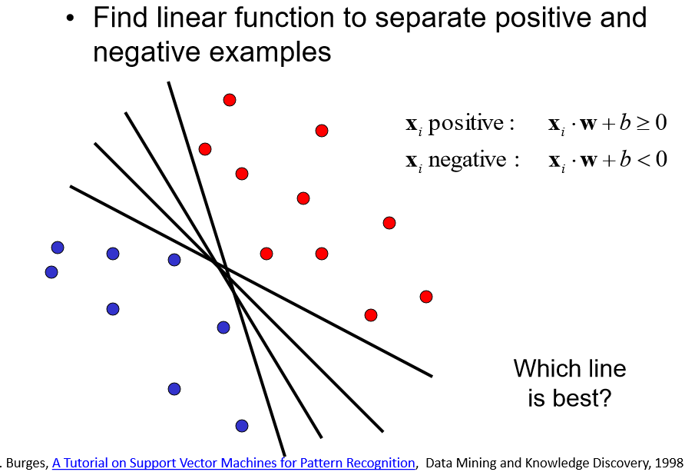
Linear Classifier

Slide 9
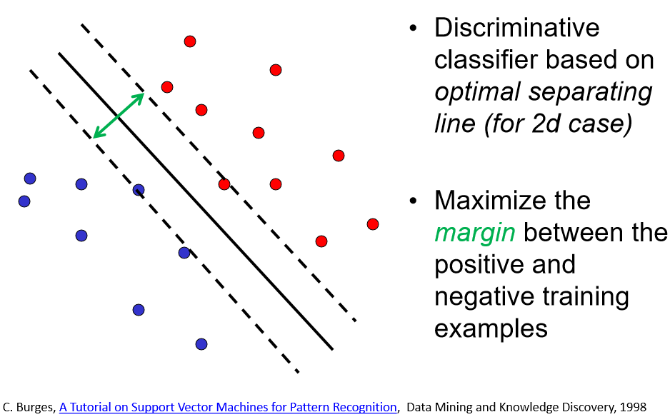
Linear Classifier
Decision Boundary

Slide 10
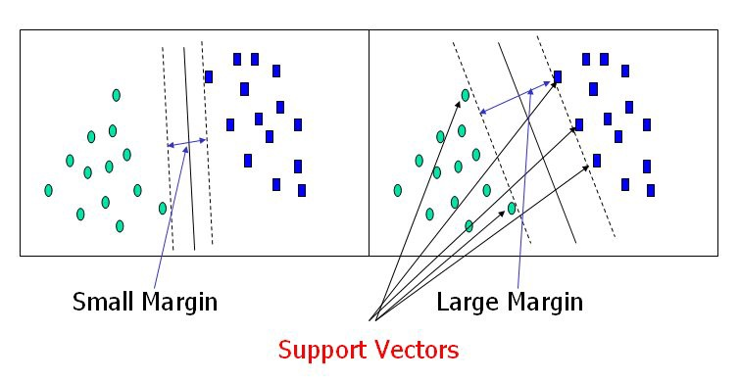
Large margin and support vectors
If hyperplane is oriented such that it is close to some of the points in your training set, new data may lie on the wrong side of the hyperplane, even if the new points lie close to training examples of the correct class.
Solution is maximizing the margin

Slide 12
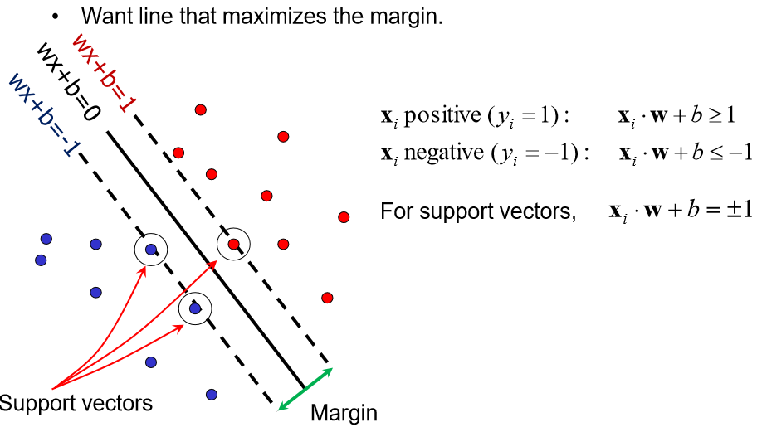
Support Vector Machines
suppose that all the training data satisfy the following constraints:

Slide 13
Maximum Margin
f(x,w,b) = sign(w x + b)
The maximum margin linear classifier is the linear classifier with the, maximum margin.
This is the simplest kind of SVM (Called an LSVM)
Find the W (that defines the decision boundary) that correctly classifies the data with biggest possible margin
denotes +1
denotes -1
Support Vectors are those datapoints that the margin pushes up against
Linear SVM

Slide 14
Support Vectors
Geometric description of SVM is that the max-margin hyperplane is completely determined by those points that lie nearest to it.
Points that lie on this margin are the support vectors.
The points of our data set which if removed, would alter the position of the dividing hyperplane
For the linearly separable case, the support vector algorithm simply looks for the separating hyperplane with largest margin.
Margin is a distance of a point(SV) and a plane

Slide 15
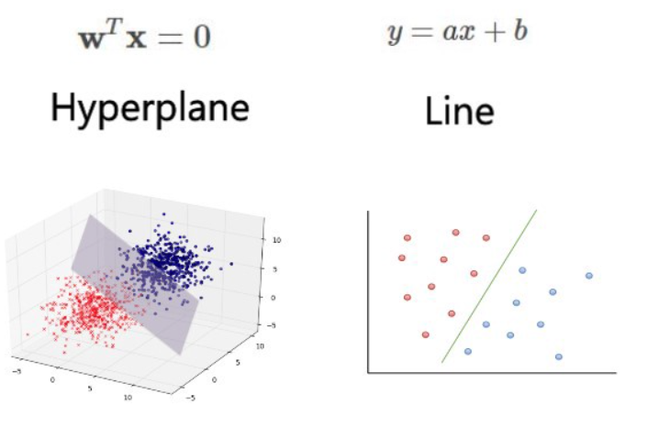
Example

Slide 16

Weight vector is perpendicular to the hyperplane
Consider points x_{a} and x_{b}, which lie on the decision boundary.
This gives us two equations:
w^{T} x_{a} +b=0
w^{T} x_{b}+b=0
Subtracting these two equations gives us
w^{T}.(x_{a} − x_{b})=0
Note that the vector x_{a} − x_{b} lies on the decision boundary,
and it is directed from x_{b} to x_{a}.
Since the dot product w^{T}.(x_{a} − x_{b}) is zero, w^{T} must be orthogonal to x_{a} − x_{b} and in turn, to the decision boundary.

Slide 17
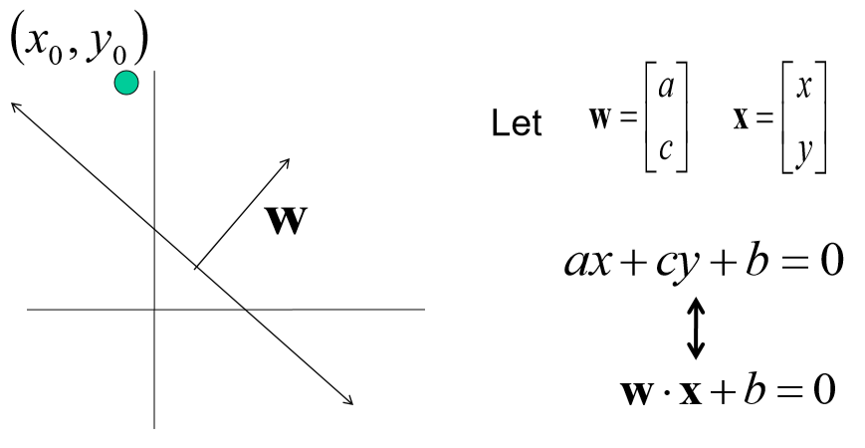
Line with 2 features: R2

Slide 18
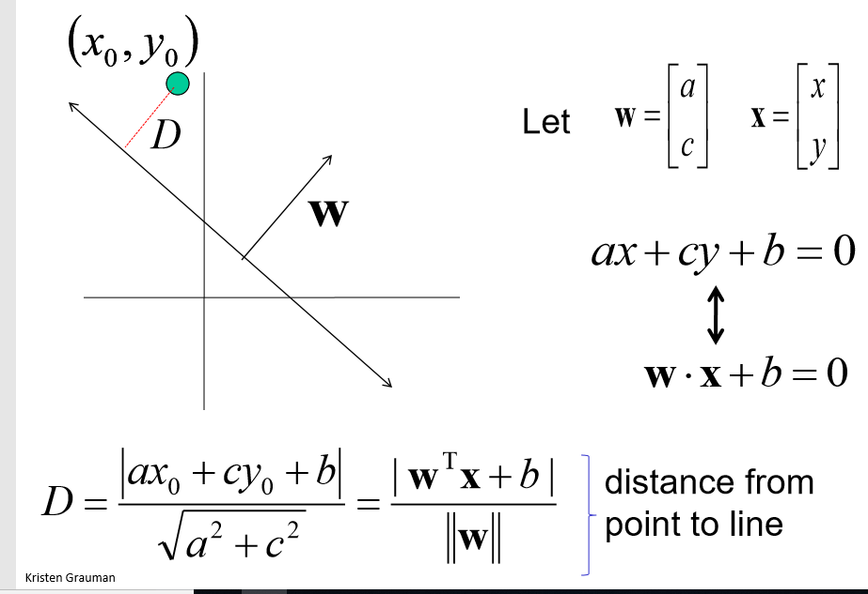
Line with 2 features: R2
https://brilliant.org/wiki/dot-product-distance-between-point-and-a-line/

Slide 19
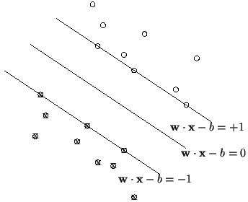
Margin
Define the hyperplanes H such that:
w•x_{i}+b ≥ +1 when y_{i} =+1
w•x_{i}+b ≤ -1 when y_{i} = –1
H₁
H₀
H₁ and H₂ are the planes:
H₁: w•x_{i}+b = +1
H₂: w•x_{i}+b = –1
The points on the planes H₁ and H₂ are the tips of the Support Vectors
H₂
_{d}+
_{d}-
H
The plane H₀ is the median in between,
where w•x_{i}+b =0
d+ = the shortest distance to the closest positive point
d- = the shortest distance to the closest negative point
The margin (gutter) of a separating hyperplane is d+ + d–.

Slide 20
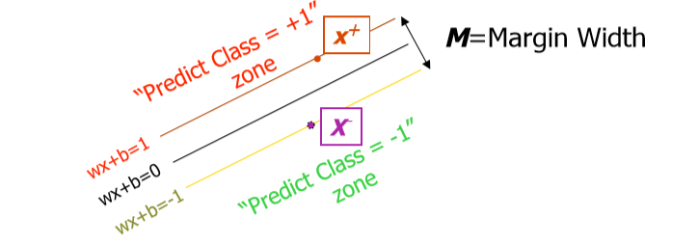
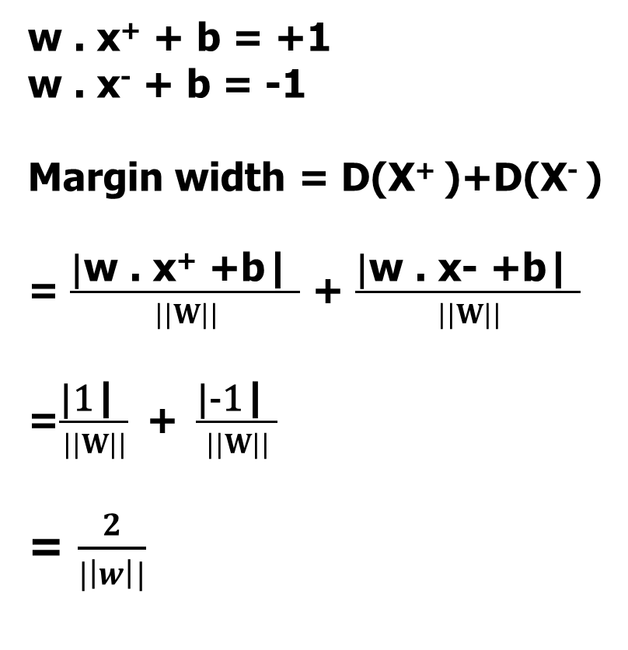
Linear SVM Mathematically
w . x⁺ + b = +1
w . x⁻ + b = -1
Margin width = D(X⁺ )+D(X⁻ )
= $\frac{\text{|}\text{w}\text{ . }\text{x}\text{+} \text{+}\text{b}\text{| }}{||W||}$ + $\frac{\text{|}\text{w}\text{ . }\text{x}\text{−}\text{ +}\text{b}\text{| }}{||W||}$
=$\frac{\text{|}\text{1}\text{| }}{||W||} \text{+ }\frac{\text{|}\text{−1}\text{| }}{||W||}$
= $\frac{2}{|\left|w\right||}$

Slide 21
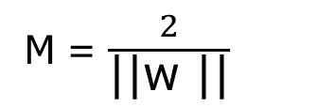
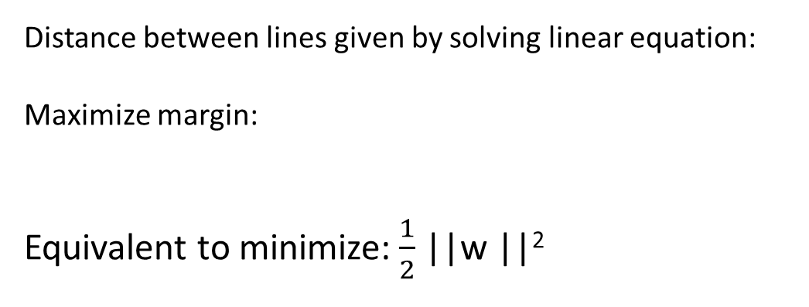
Linear SVM Mathematically
x⁺
M=Margin Width
“Predict Class = +1” zone
X⁻
wx+b=1
“Predict Class = -1” zone
wx+b=0
wx+b=-1
Distance between lines given by solving linear equation:
Maximize margin:
Equivalent to minimize:$\frac{1}{2}$ ||w ||²
What we know:
w . x⁺ + b = +1
w . x⁻ + b = -1
M = $\frac{2}{\text{||}\text{w}\text{ ||}}$

Slide 22
Constraints
In order to maximize the margin, we thus need to minimize ||w||.
With the condition that there are no datapoints between H₁ and H₂:
x_{i}•w+b ≥ +1 when y_{i} =+1
x_{i}•w+b ≤ –1 when y_{i} =–1
Can be combined into: y_{i}(x_{i}•w) ≥ 1
y_{i} (w^{T}x_{i} + b) ≥ 1
+1(w^{T}x_{i} + b) ≥ 1
-1(w^{T}x_{i} + b) ≤ 1
same as (w^{T}x_{i} + b) ≥ 1

Slide 23
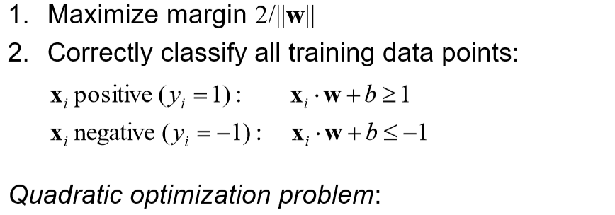
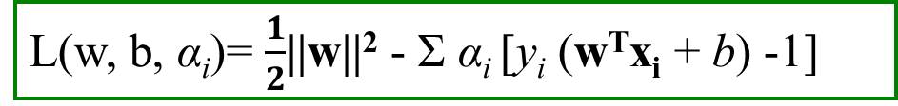
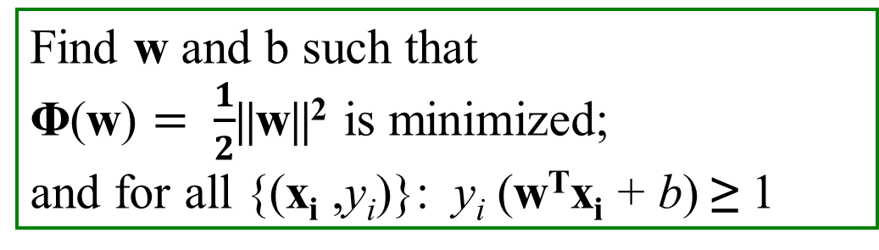
Solving the Optimization Problem
L(w, b, α_{i})= $\frac{1}{2}$||w||² - Σ α_{i} [y_{i} (w^{T}x_{i} + b) -1]
Find w and b such that
Φ(w) $= \frac{1}{2}$||w||² is minimized;
and for all {(x_{i} ,y_{i})}: y_{i} (w^{T}x_{i} + b) ≥ 1
y_{i} (w^{T}x_{i} + b) ≥ 1
+1(w^{T}x_{i} + b) ≥ 1
-1(w^{T}x_{i} + b) ≤ 1
same as (w^{T}x_{i} + b) ≥ 1

Slide 24
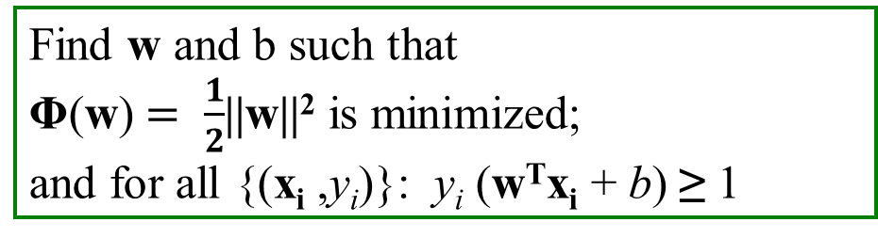
Solving the Optimization Problem
Find w and b such that
Φ(w) $= \frac{1}{2}$||w||² is minimized;
and for all {(x_{i} ,y_{i})}: y_{i} (w^{T}x_{i} + b) ≥ 1
← Primal
Need to optimize a quadratic function subject to linear inequality constraints.
All constraints in SVM are linear
Quadratic optimization problems are a well-known class of mathematical programming problems, and many (rather intricate) algorithms exist for solving them.
The solution involves constructing a unconstrained problem where a Lagrange multiplier α_{i} is associated with every constraint in the primary problem:

Slide 25
Optimization using Langrangian

Slide 26
Optimization Problem
Optimization problem is typically written:
Minimize f(x)
subject to
gi(x) = 0, i=1,…,p
hi(x) <= 0, i=1,…,m
f(x) is called the objective function
By changing x (the optimization variable) we wish to find a value x∗ for which f(x) is at its minimum.
p functions of gi define equality constraints and
m functions hi define inequality constraints.
The value we find MUST respect these constraints!

Slide 27
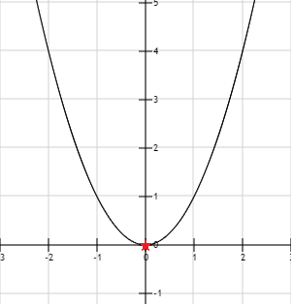
Unconstrained Optimization
Minimize x²

Slide 28
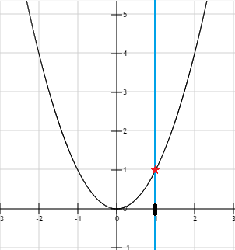
Constrained Optimization -Equality Constraint
Minimize x²
Subject to x = 1

Slide 29
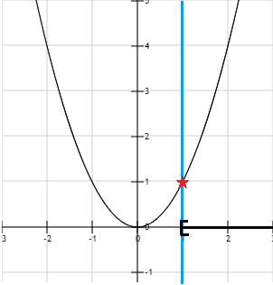
Constrained Optimization -Inequality Constraint
Minimize x²
Subject to x >= 1

Slide 30
Constrained optimization
We can also have mix equality and inequality constraints together.
Only restriction is that if we use contradictory constraints, we can end up with a problem which does not have a feasible set
Minimize x²
Subject to
x = 1
x < 0
Impossible for x to be equal 1 and less than zero at the same

Slide 31
Constrained optimization
A solution is an assignment of values to variables.
A feasible solution is an assignment of values to variables such that all the constraints are satisﬁed.
The objective function value of a solution is obtained by evaluating the objective function at the given solution.
An optimal solution (assuming minimization) is one whose objective function value is less than or equal to that of all other feasible solutions.

Slide 32
Lagrange Multipliers
How do we find the solution to an optimization problem with constraints?
Constrained maximization (minimization) problem is rewritten as a Lagrange function whose optimal point is a saddle point, i.e. a global maximum (minimum)
Lagrange function use Lagrange multipliers is a strategy for finding the local maxima and minima of a function subject to constraints

Slide 33
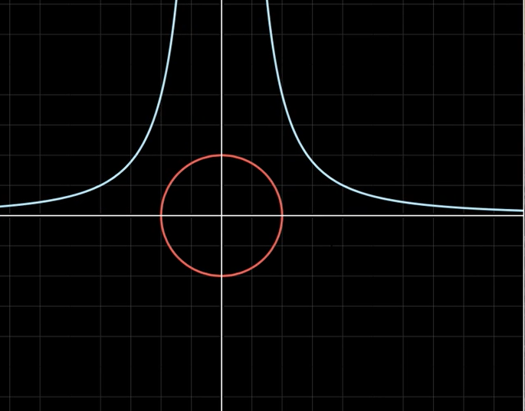
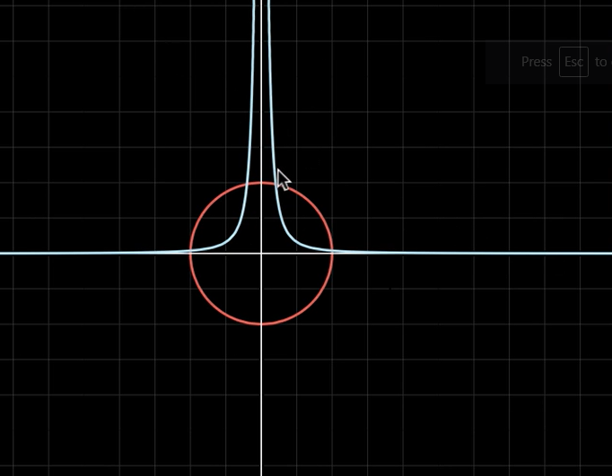
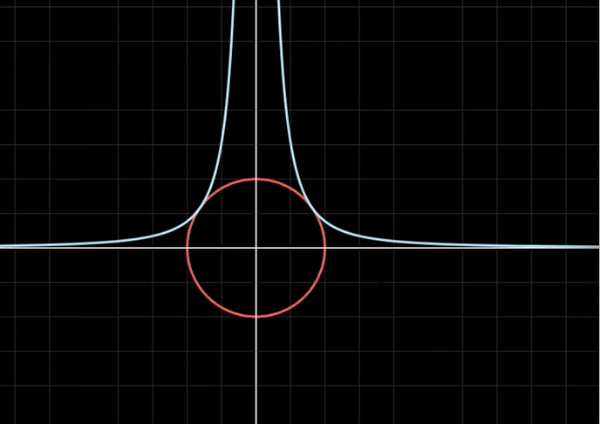
Maximize
f(x,y) = x² y
Subject to
g(x, y) : x² + y² = 1
f(x,y) = K
Larger constant K Smaller constant K
Maximize the function for
some value of K

Slide 34
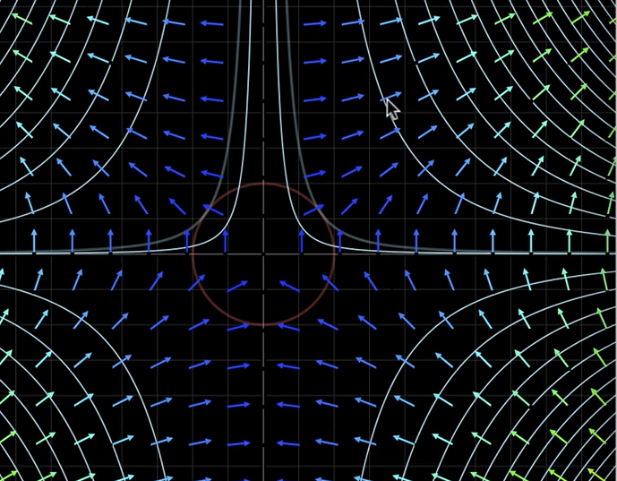
Gradients are perpendicular to various contour lines(w.r.t to different values of function)
of function f
Function is not changing the value along the points on any the contour line

Slide 35
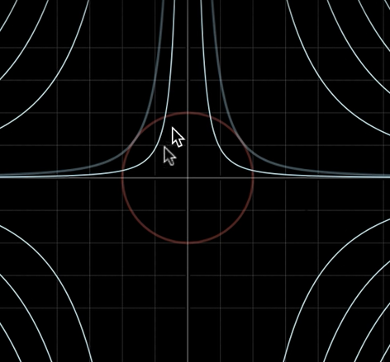
Constrained to Unconstrained Optimization: Lagrange Multiplier
Maximum of f(x,y) under constraint
g(x, y) is obtained when their gradients point to same direction
(when they are tangent to each other).
Introduce a Lagrange multiplier λ for the equality constraint
Mathematically,
∇ f(x,y) = λ ∇ g(x,y)
Equivalently:
L(x,y, λ) = f(x,y) –λ.g(x,y)-C
Optimize L using gradients
∇ L(x,y, λ )=0

Slide 36
Example:
Introduce a Lagrange multiplier λ for constraint
Construct the Lagrangian
Stationary points
-
--
x and y values remain same even if you take +λ or -λ for equality constraint
2 x = 6
x = y = 3
λ = 3

Slide 37
Karush–Kuhn–Tucker (KKT) theorem
KKT approach to nonlinear programming (quadratic) generalizes the method of Lagrange multipliers, which allows only equality constraints.
KKT allows inequality constraints

Slide 38
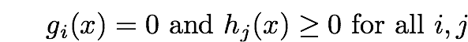
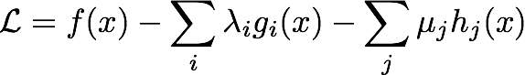
Karush-Kuhn-Tucker (KKT) conditions
Start with
max f(x) subject to
f is the objective function, g_{i} (i=1 ….m) are the equality constraint functions and h_{j} (j=1….l ) are the inequality constraint functions
Make the Lagrangian function
Take gradient and set to 0 – but satisfy other conditions also.

Slide 39
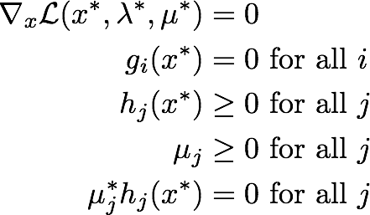
KKT conditions
Make the Lagrangian function
Necessary conditions to have a minimum are
Stationarity
primal feasibility condition
primal feasibility condition
dual feasibility condition
complementary slackness condition

Slide 40
Solving SVM using KKT conditions

Slide 41


SVM objective function
max f(x) subject to
Find w and b such that
Φ(w) $= \frac{1}{2}$||w||² is minimized;
and for all {(x_{i} ,y_{i})}: y_{i} (w^{T}x_{i} + b) ≥ 1
L(w, b, α_{i})= $\frac{1}{2}$||w||² - Σ α_{i} [y_{i} (w^{T}x_{i} + b) -1]

Slide 42
Dual problem
This is constrained optimization problem , popularly known as convex optimization problem, where objective function is quadratic and constraints are linear in the parameters W and b.
The solution involves constructing a dual problem where a Lagrange multiplier α_{i} is associated with every constraint in the primary problem:

Slide 43

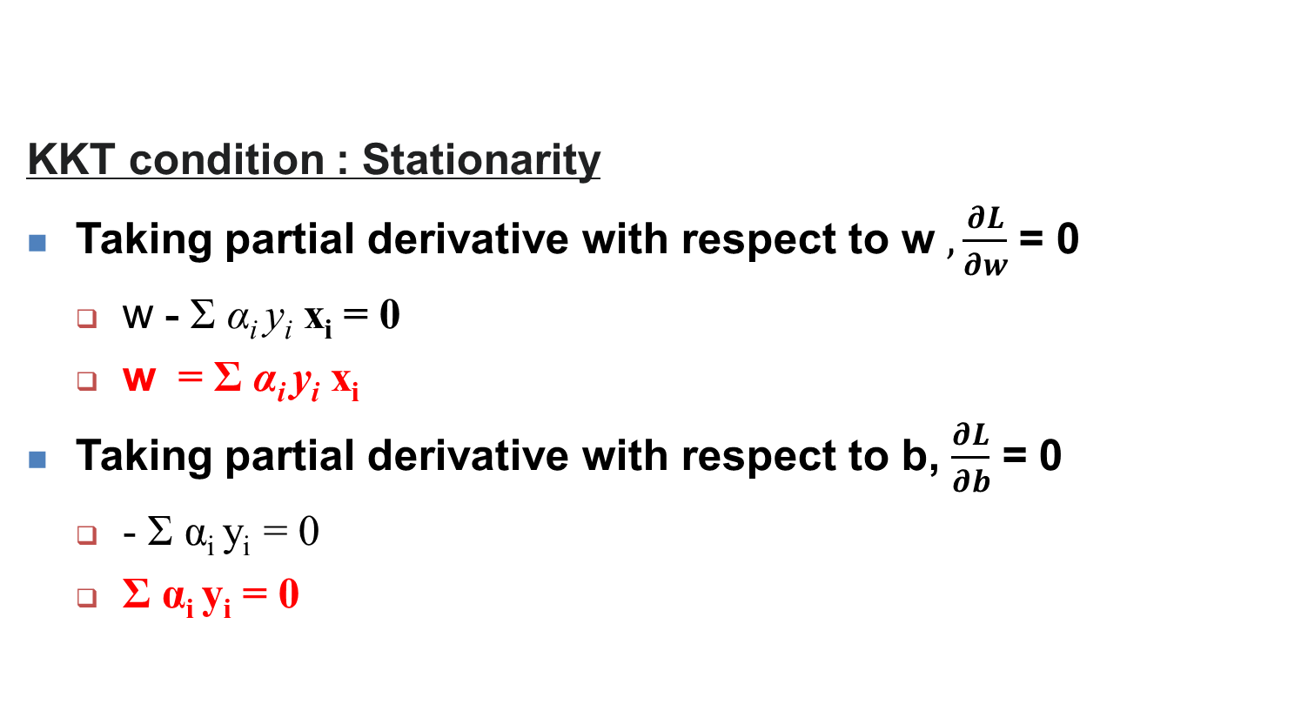
Solving the Optimization Problem
KKT condition : Stationarity
Taking partial derivative with respect to w $, \frac{∂L}{∂w}$ = 0
w - Σ α_{i} y_{i} x_{i} = 0
w = Σ α_{i} y_{i} x_{i}
Taking partial derivative with respect to b, $\frac{∂L}{∂b}$ = 0
- Σ α_{i} y_{i} = 0
Σ α_{i} y_{i} = 0
L(w, b, α_{i})= $\frac{1}{2}$||w||² - Σ α_{i} [y_{i} (w^{T}x_{i} + b) -1]

Slide 44
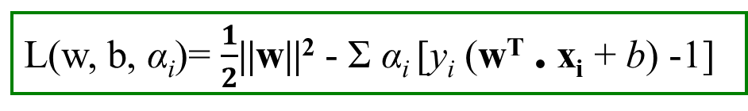
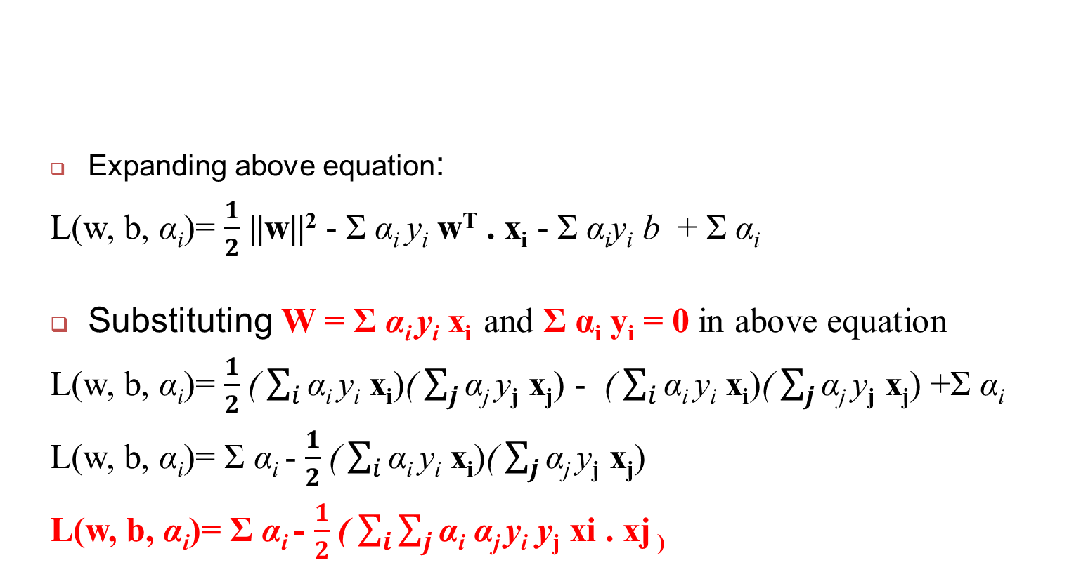
Solving the Optimization Problem
Expanding above equation:
L(w, b, α_{i})= $\frac{1}{2}$ ||w||² - Σ α_{i} y_{i} w^{T} . x_{i} - Σ α_{i}y_{i} b + Σ α_{i}
Substituting W = Σ α_{i} y_{i} x_{i} and Σ α_{i} y_{i} = 0 in above equation
L(w, b, α_{i})= $\frac{1}{2}$($\sum_{i}{\text{α}\text{i} \text{y}\text{i} \text{x}\text{i}}$)($\sum_{j}{\text{α}\text{j} \text{y}\text{j} \text{x}\text{j}}$) - ($\sum_{i}{\text{α}\text{i} \text{y}\text{i} \text{x}\text{i}}$)($\sum_{j}{\text{α}\text{j} \text{y}\text{j} \text{x}\text{j}}$) +Σ α_{i}
L(w, b, α_{i})= Σ α_{i} - $\frac{1}{2}$($\sum_{i}{\text{α}\text{i} \text{y}\text{i} \text{x}\text{i}}$)($\sum_{j}{\text{α}\text{j} \text{y}\text{j} \text{x}\text{j}}$)
L(w, b, α_{i})= Σ α_{i} - $\frac{1}{2}$( $\sum_{i}{\sum_{j}{\text{α}\text{i} \text{α}\text{j} \text{y}\text{i} \text{y}\text{j} \text{xi}\text{ . }\text{xj}\text{ ) } }}$
L(w, b, α_{i})= $\frac{1}{2}$||w||² - Σ α_{i} [y_{i} (w^{T} . x_{i} + b) -1]

Slide 45

L(w, b, α_{i})= $\frac{1}{2}$||w||² - Σ α_{i} [y_{i} (w^{T}x_{i} + b) -1]
Using KKT complementary slackness condition
α_{i} [y_{i} (w^{T}x_{i} + b) -1]=0
For this condition to be satisfied either α_{i} =0 and y_{i} (w^{T}x_{i} + b) -1 > 0 OR
y_{i} (w^{T}x_{i} + b) -1=0 and α_{i} > 0
Using dual feasibility condition α_{i} >= 0
case 1 : α_{i} > 0
For support vectors: {w^{T}x_{i} + b = +1 when Y=1or : w^{T}x_{i} + b = -1 when Y=-1}
y_{i} (w^{T}x_{i} + b) -1=0
case 2 : α_{i} = 0
For all points other than support vectors:
α_{i} =0

Slide 46


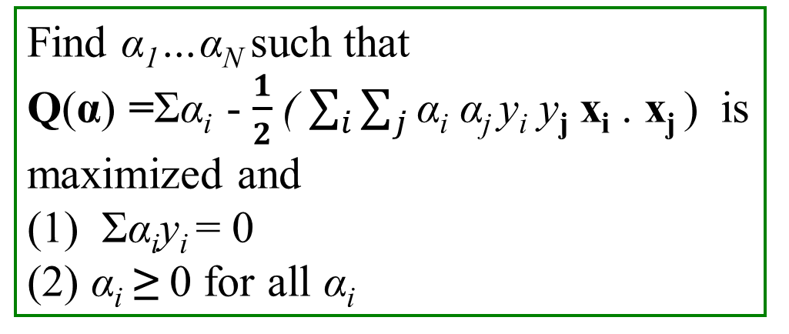
Linear SVM summary – 1 SVM Optimization Problem
Find w and b such that
Φ(w) $= \frac{1}{2}$||w||² is minimized;
and for all {(x_{i} ,y_{i})}: y_{i} (w^{T}x_{i} + b) ≥ 1
L(w, b, α_{i})= $\frac{1}{2}$||w||² - Σ α_{i} [y_{i} (w^{T}x_{i} + b) -1]
Find α₁…α_{N} such that
Q(α) =Σα_{i} - $\frac{1}{2}$( $\sum_{i}{\sum_{j}{\text{α}\text{i} \text{α}\text{j} \text{y}\text{i} \text{y}\text{j} \text{x}\text{i}\text{ . }\text{x}\text{j} \text{)} }}$is maximized and
(1) Σα_{i}y_{i} = 0
(2) α_{i} ≥ 0 for all α_{i}

Slide 47
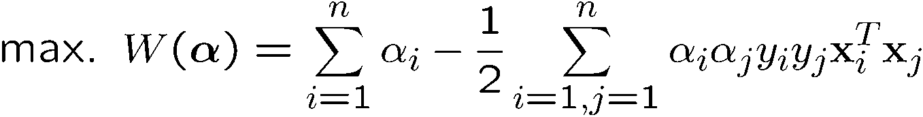
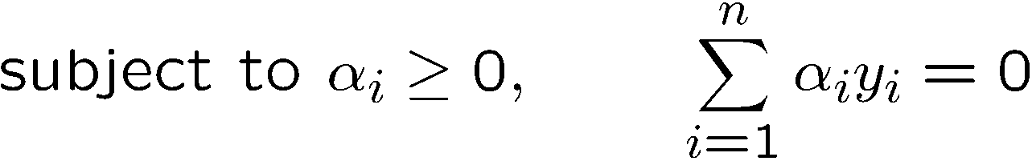
The Dual Problem
The new objective function is in terms of α_{i} only
It is known as the dual problem: if we know w, we know all α_{i}; if we know all α_{i}, we know w
The original problem is known as the primal problem
The objective function of the dual problem needs to be maximized (comes out from the KKT theory)
The dual problem is therefore:
Properties of α_{i} when we introduce the Lagrange multipliers
The result when we differentiate the original Lagrangian w.r.t. b

Slide 48
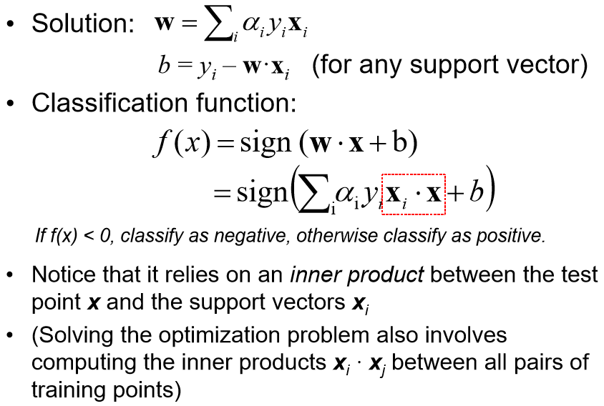
Solving the Optimization Problem

Slide 49
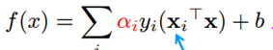
Linear SVM summary – 2 Parameters to learn – W, b, α_{i}
Calculate α_{i}
SVM Classification function For support vectors
Calculate W and b
α_{i} [-1 (w . x_{i} + b)] = -1
α_{i} [+1 (w . x_{i} + b)] = 1
w = Σ α_{i} y_{i} x_{i}
b = y_{i} – W.x_{i}

Slide 50

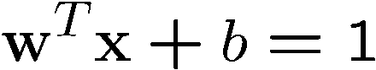
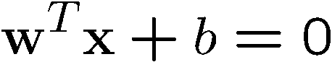
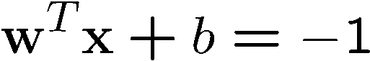
A Geometrical Interpretation
Class 2
α₁₀=0
α₈=0.6
α₇=0
α₂=0
α₅=0
α₁=0.8
α₄=0
α₆=1.4
α₉=0
α₃=0
Class 1

Slide 51
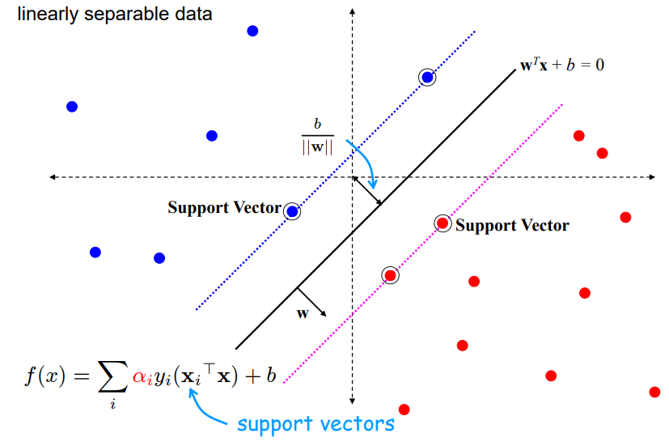
Substituting w in support vectors function

Slide 52
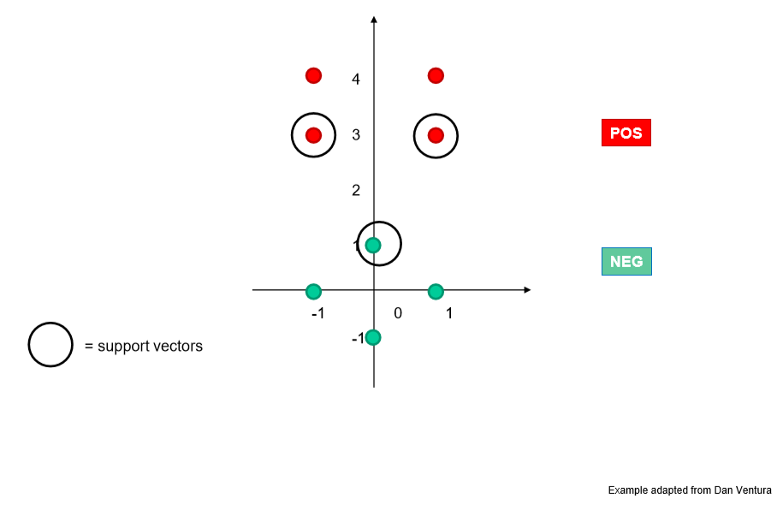
Example
x₂
x₃
x₁

Slide 53
Solving for α
We know that for the support vectors, f(x) = 1 or -1 exactly
Add a 1 in the feature representation for the bias
The support vectors have coordinates and labels:
x1 = [0 1 1], y1 = -1
x2 = [-1 3 1], y2 = +1
x3 = [1 3 1], y3 = +1
Thus we can form the following system of linear equations:

Slide 54
Solving for α
α_{i} [-1 (w . x_{i} + b)] = -1
α_{i} [+1 (w . x_{i} + b)] = 1
System of linear equations:
α₁. y₁. (x₁^{T} . x₁)+ α₂ . Y_{2 .} (x₁^{T} . x₂)+ α₃ . y₃ . (x₁^{T} . x3) = y₁
α₁. y₁. (x₂^{T} . x₁)+ α₂ . Y_{2 .} (x₂^{T} . x₂)+ α₃ . y₃ . (x₂^{T} . x3) = y₂
α₁. y₁. (x₃^{T} . x₁)+ α₂ . Y_{2 .} (x₃^{T} . x₂)+ α₃ . y₃ . (x₃^{T} . x3) = y₃
-2 * α1 + 4 * α2 + 4 * α3 = -1
-4 * α1 + 11 * α2 + 9 * α3 = +1
-4 * α1 + 9 * α2 + 11 * α3 = +1
Solution: α1 = 3.5, α2 = 0.75, α3 = 0.75

Slide 55
Solving for w, b; plotting boundary
We know w = Σ α_{i} y_{i} x_{i} i.e w = α₁ y₁ x₁ + … + α_{N} y_{N} x_{N}
where N = No of SVs
Thus w = -3.5 * [0 1 1] + 0.75 [-1 3 1] + 0.75 [1 3 1] = [0 1 -2]
Separating out weights and bias, we have: w = [0 1] and b = -2
a=0, c=1
Boundary:
For SVMs, we used this eq for a line: ax + cy + b = 0 where w = [a c]
Thus ax + b = -cy ➔ y = (-a/c) x + (-b/c)
Thus y-intercept is (-b/c) = -(-2)/1 = 2
The decision boundary is perpendicular to w and it has slope
=(-a/c) = -0/1 = 0

Slide 56
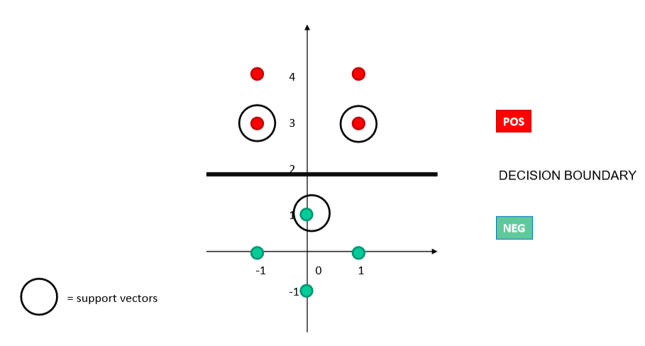
Decision boundary

Slide 57
Good Web References for SVM
Text categorization with Support Vector Machines: learning with many relevant features - T. Joachims, ECML
A Tutorial on Support Vector Machines for Pattern Recognition, Kluwer Academic Publishers - Christopher J.C. Burges
http://www.cs.utexas.edu/users/mooney/cs391L/
https://www.coursera.org/learn/machine-learning/home/week/7
https://towardsdatascience.com/support-vector-machine-introduction-to-machine-learning-algorithms-934a444fca47
https://data-flair.training/blogs/svm-kernel-functions/
MIT 6.034 Artificial Intelligence, Fall 2010
https://stats.stackexchange.com/questions/30042/neural-networks-vs-support-vector-machines-are-the-second-definitely-superior
https://www.sciencedirect.com/science/article/abs/pii/S0893608006002796
https://medium.com/deep-math-machine-learning-ai/chapter-3-support-vector-machine-with-math-47d6193c82be
https://www.svm-tutorial.com/

Slide 58
Thank You
13 March 2022

